Slide 1
Seaching, Sorting and recursive algorithms

Slide 2
01
02
Binary Search
Search algorithms
Linear Search
Binary Search
Iterative Algorithm
Iterative java code
03
Linear Search
04
Binary Search
Linear Algorithm
Java code
Recursive Algorithm
Recursive java code
Objectives

Slide 3
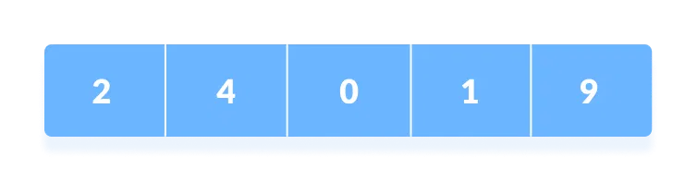
Searching Algorithm (Linear Search)
Linear search is a sequential searching algorithm where we start from one end and check every element of the list until the desired element is found.
For example, consider the array below:

Slide 4
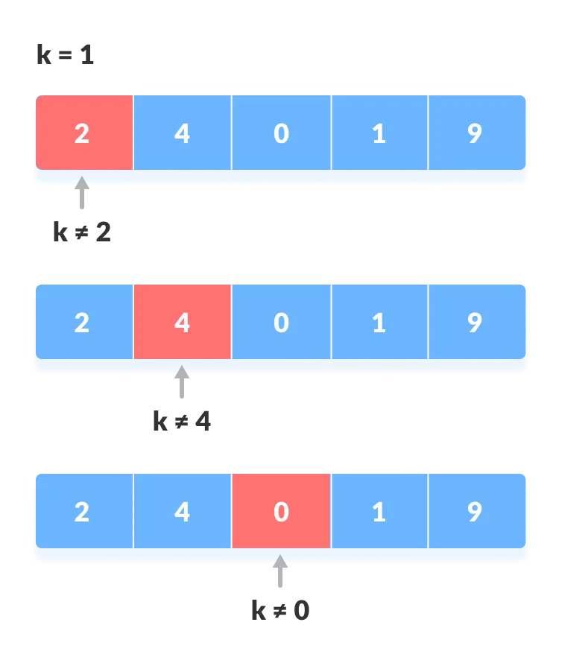
Linear Search

Slide 5
Linear Search Algorithm
The algorithm for Linear search would look like:
LinearSearch(array, key)
for each item in the array
if item == value
return its index

Slide 6
Linear Search java code
class LinearSearch {
public static int linearSearch(int array[], int x) {
int n = array.length;
// Going through array sequencially
for (int i = 0; i < n; i++) {
if (array[i] == x)
return i;
}
return -1;
}

Slide 7
Linear Search java code
public static void main(String args[]) {
int array[] = { 2, 4, 0, 1, 9 };
int x = 1;
int result = linearSearch(array, x);
if (result == -1)
System.out.print("Element not found");
else
System.out.print("Element found at index: " + result);
}
}

Slide 8
Binary Search
Binary Search is a searching algorithm for finding an element's position in a sorted array.
Binary search can be implemented only on a sorted list of items.
If the elements are not sorted already, we need to sort them first.
It can be implemented in two ways:
Iterative method
Recursive method

Slide 9
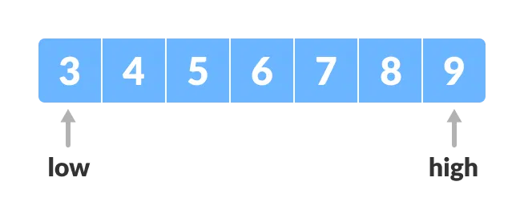
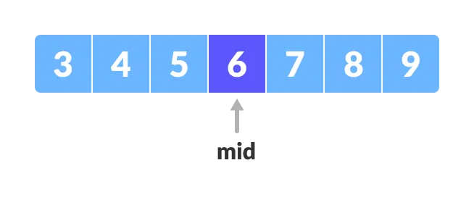
Binary Search
Set two pointers low and high at the lowest and the highest positions respectively.
Find the middle position mid of the array.

Slide 10
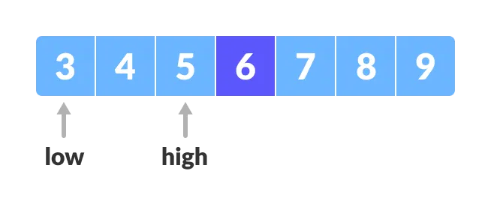
Binary Search cont.
If x == arr[mid], then return mid.
If x > arr[mid], compare x with the middle element of the elements on the right side of arr[mid]. This is done by setting low to low = mid + 1.
Else, compare x with the middle element of the elements on the left side of arr[mid]. This is done by setting high to high = mid - 1.

Slide 11
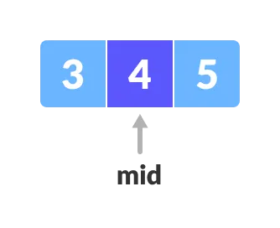
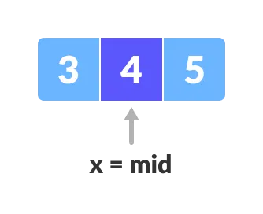
Binary Search
Binary Repeat steps 3 to 6 until low meets high.
x = 4 is found.

Slide 12
Binary Search Algorithm
Iterative:
do until the pointers low and high meet each other.
mid = (low + high)/2
if (x == arr[mid])
return mid
else if (x > arr[mid]) // x is on the right side
low = mid + 1
else // x is on the left side
high = mid - 1

Slide 13
class BinarySearch {
int binarySearch(int array[], int x, int low, int high) {
// Repeat until the pointers low and high meet each other
while (low <= high) {
int mid = low + (high - low) / 2;
if (x == array[mid])
return mid;
if (x > array[mid])
low = mid + 1;
else
high = mid - 1;
}
return -1;
}

Slide 14
public static void main(String args[]) {
BinarySearch ob = new BinarySearch();
int array[] = { 3, 4, 5, 6, 7, 8, 9 };
int n = array.length;
int x = 4;
int result = ob.binarySearch(array, x, 0, n - 1);
if (result == -1)
System.out.println("Not found");
else
System.out.println("Element found at index " + result);
}
}

Slide 15
Binary Search Algorithm
Recursive:
binarySearch(arr, x, low, high)
if low > high
return False
else
mid = (low + high) / 2
if x == arr[mid]
return mid
else if x > arr[mid] // x is on the right side
return binarySearch(arr, x, mid + 1, high)
else // x is on the left side
return binarySearch(arr, x, low, mid - 1)

Slide 16
class BinarySearch {
int binarySearch(int array[], int x, int low, int high) {
if (high >= low) {
int mid = low + (high - low) / 2;
// If found at mid, then return it
if (x == array[mid])
return mid;
// Search the right half
if (x > array[mid])
return binarySearch(array, x, mid + 1, high);
// Search the left half
return binarySearch(array, x, low, mid - 1);
}
return -1;
}

Slide 17
public static void main(String args[]) {
BinarySearch ob = new BinarySearch();
int array[] = { 3, 4, 5, 6, 7, 8, 9 };
int n = array.length;
int x = 4;
int result = ob.binarySearch(array, x, 0, n - 1);
if (result == -1)
System.out.println("Not found");
else
System.out.println("Element found at index " + result);
}
}

Slide 18

THANK YOU

